Slide 1

Evacuation Bottleneck: Simulation and analysis of an evacuation of a high-school building with MATLAB
Swiss-Slovak Misunderstanding
by Alexander Jöhl & Tomáš Nyitray
Swiss-Slovak Misunderstanding

Slide 2
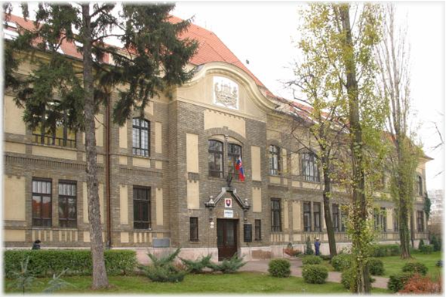
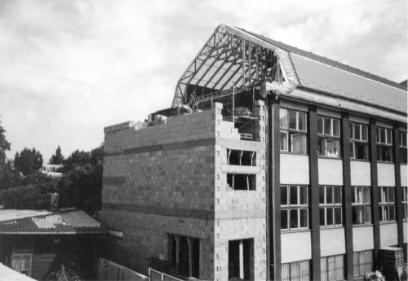
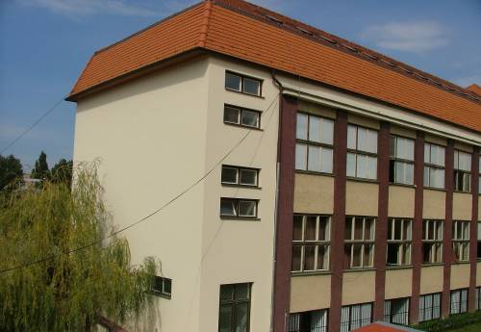
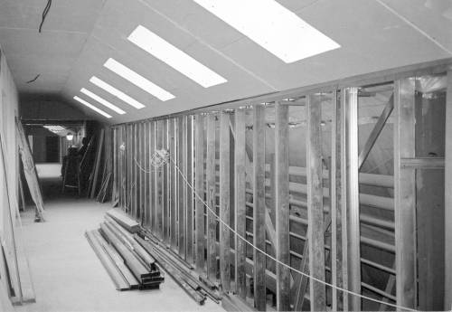
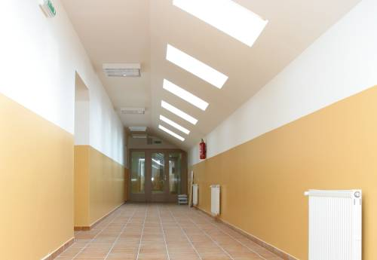
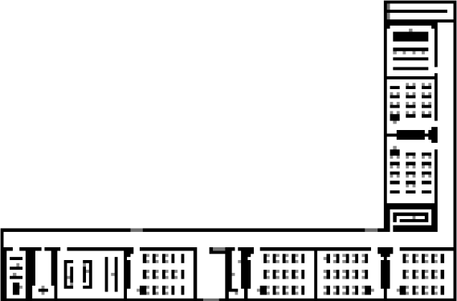
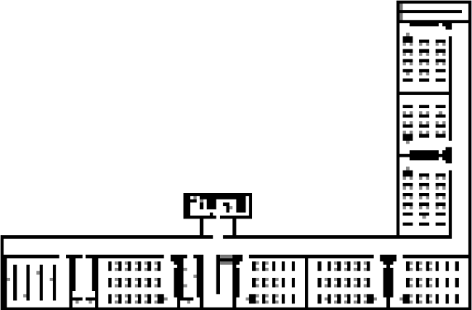
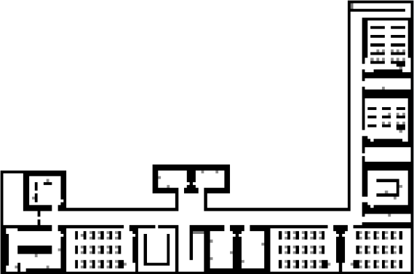
Gymnázium Ľudovíta Jaroslava Šuleka in Komárno, Slovakia
Swiss-Slovak Misunderstanding
Source: www.gljs.sk

Slide 3

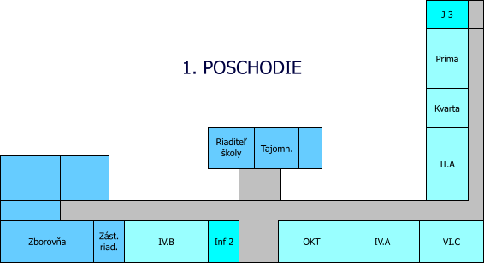

Drawing of the floors with GIMP 2
Swiss-Slovak Misunderstanding
Source: www.gljs.sk
Grey-scale .bmp picture

Slide 4
Shortest distance vs. Minimal waiting time
Swiss-Slovak Misunderstanding
Not each agent is autonomous
Young students following the basic evacuation rules
Class must stay together and evacuate through the nearest exit
Principle of the shortest distance

Slide 5
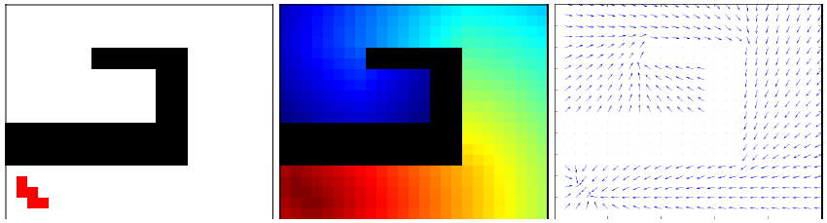
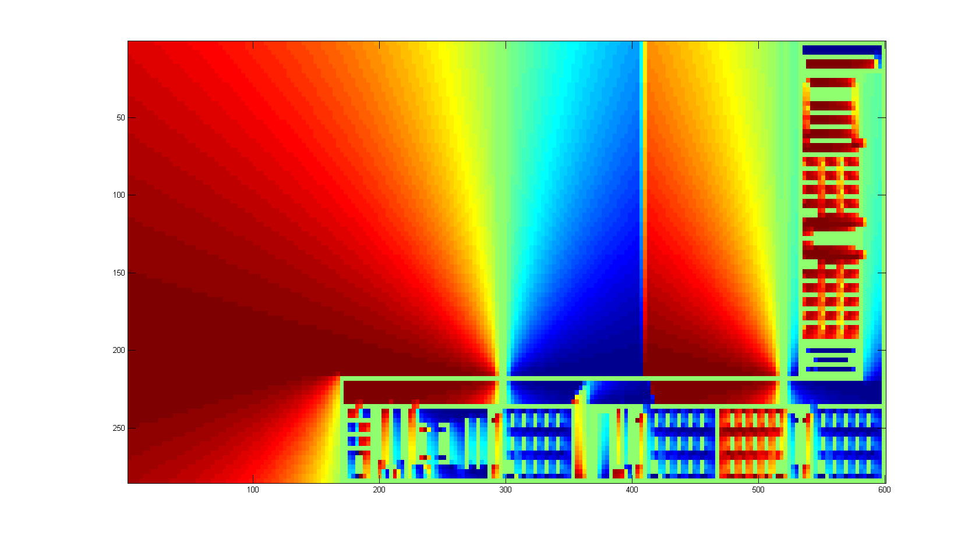
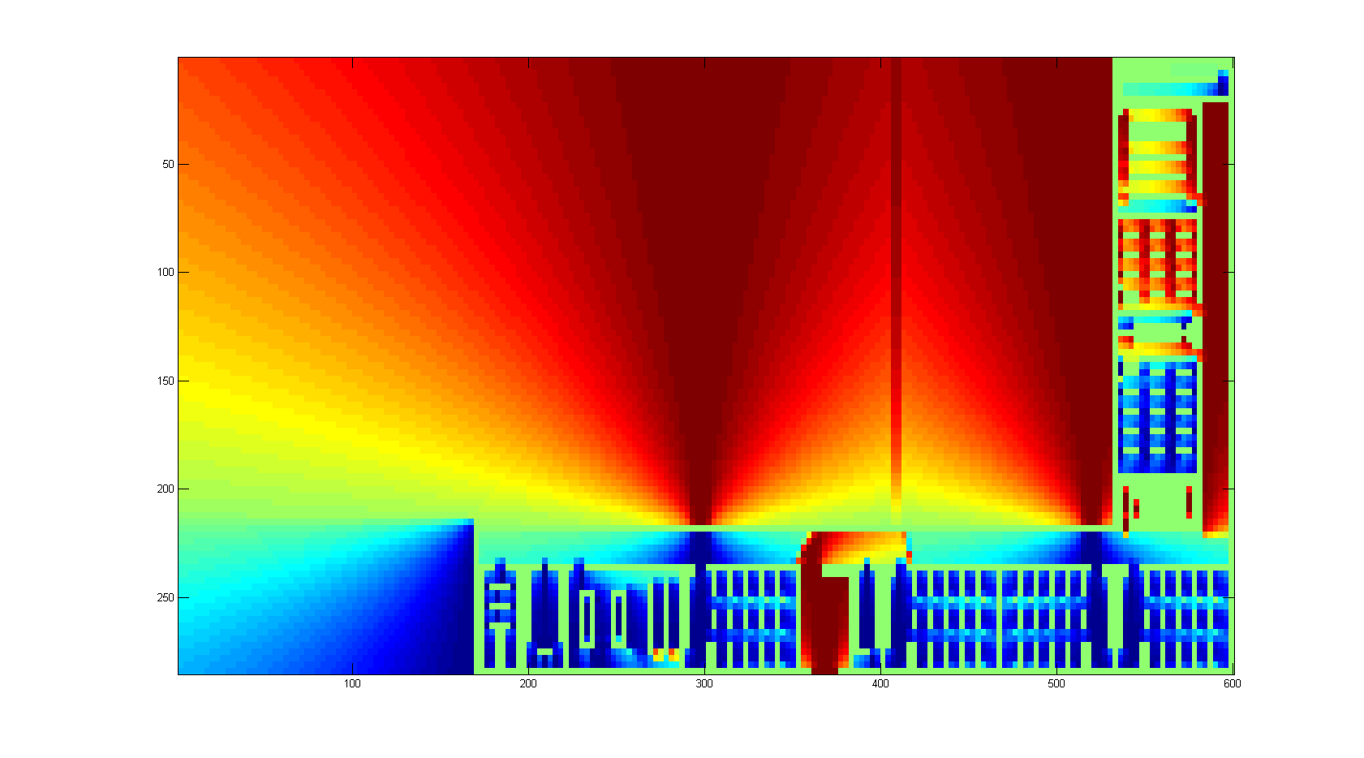
Swiss-Slovak Misunderstanding
Fast marching Toolbox
Source: Heer P. and Bühler L.: Pedestrian Dynamics, Airplane Evacuation Simulation

Slide 6
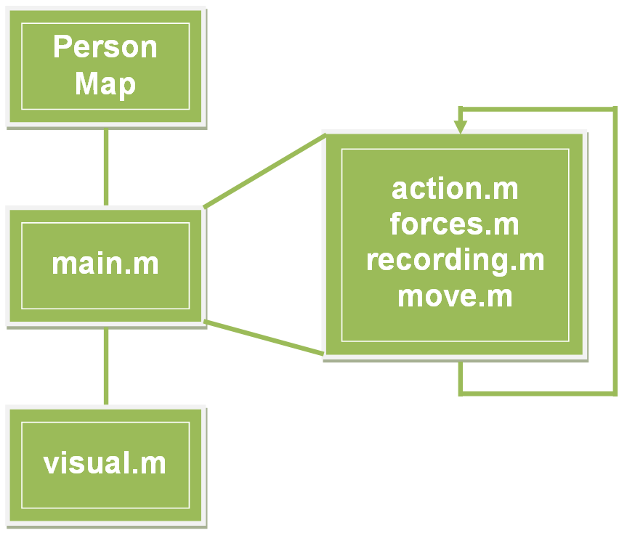
Swiss-Slovak Misunderstanding
flowchart of the matlab code

Slide 7
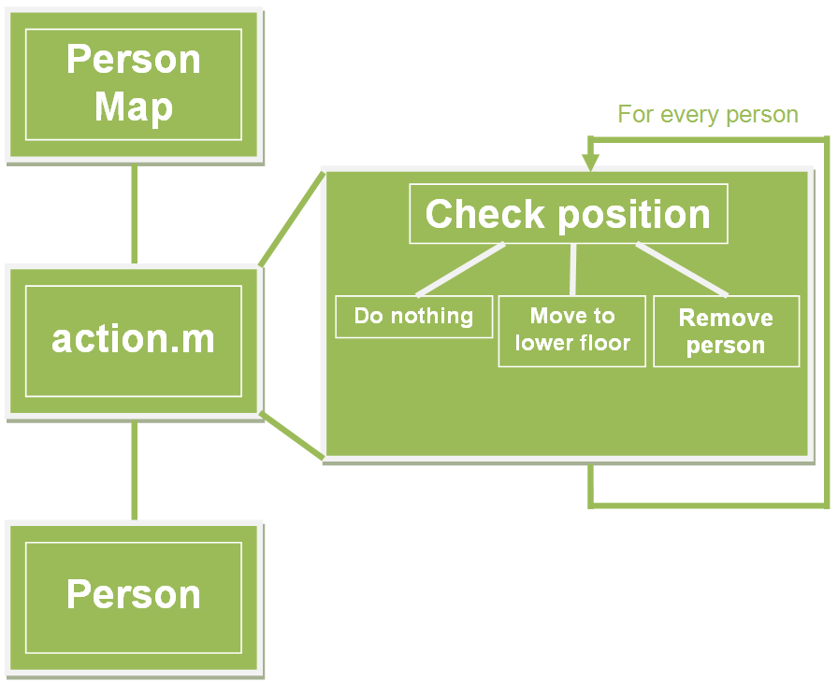
Swiss-Slovak Misunderstanding
flowchart of the action function

Slide 8
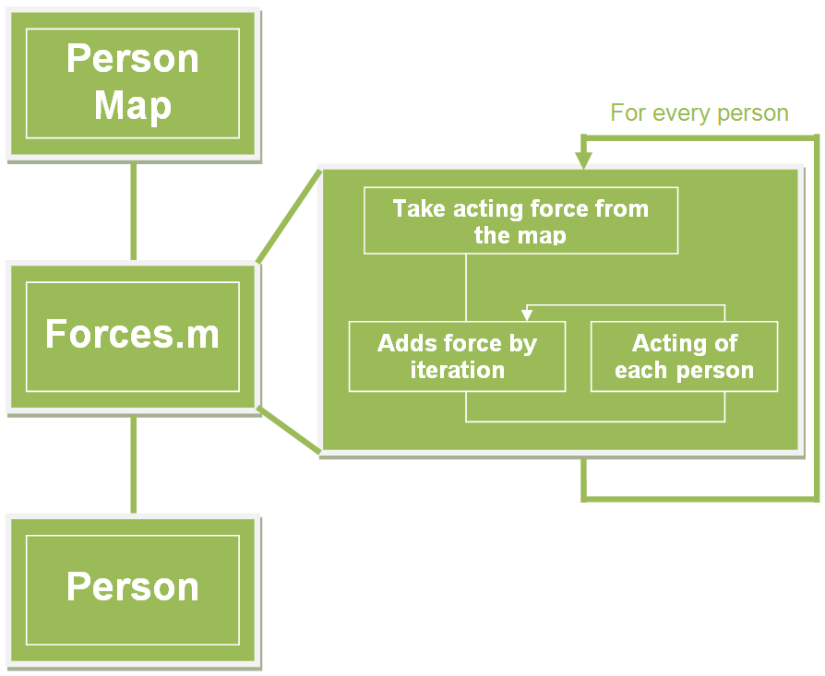
Swiss-Slovak Misunderstanding
flowchart of the forces function

Slide 9
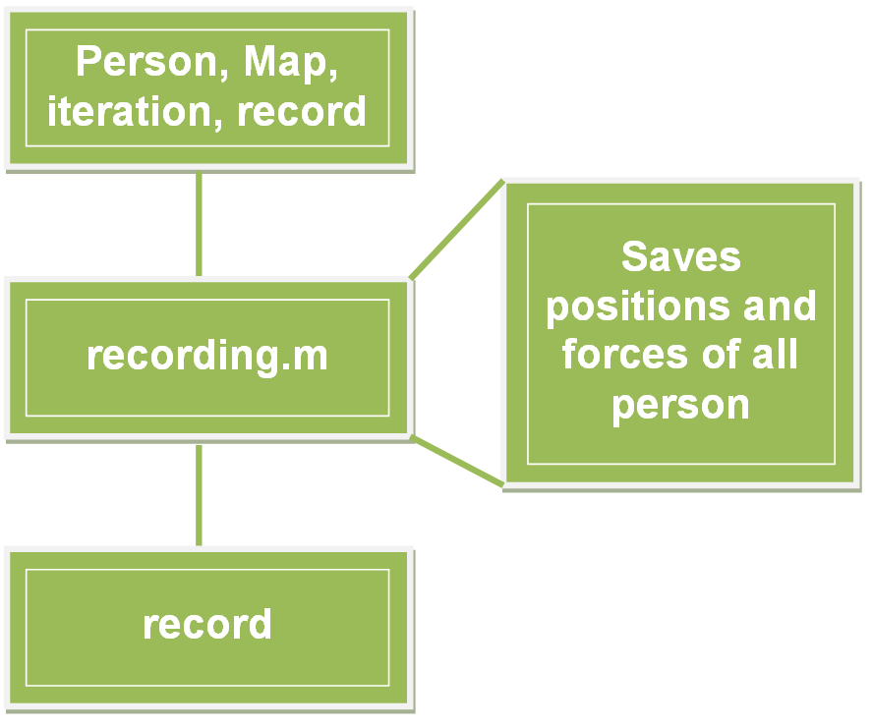
Swiss-Slovak Misunderstanding
flowchart of the recording function

Slide 10
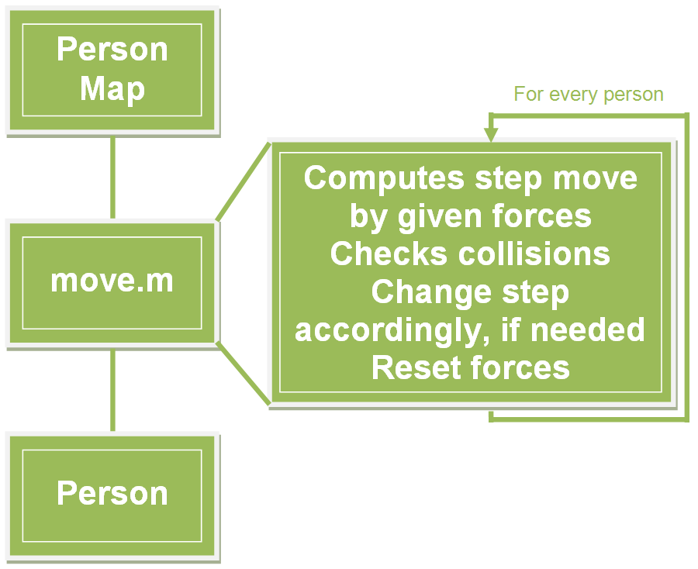
Swiss-Slovak Misunderstanding
flowchart of the move function

Slide 11

Swiss-Slovak Misunderstanding
flowchart of the visual function

Slide 12
Swiss-Slovak Misunderstanding
Our expectations
The best tactic for the persons on the highest floor is to take the fire stairs because they would not get stuck in the row
We are expecting bottle neck problems especially because the agents are using the principle of shortest distance
The evacuation time will be more than 90 seconds
3 iterations equal to one second

Slide 13
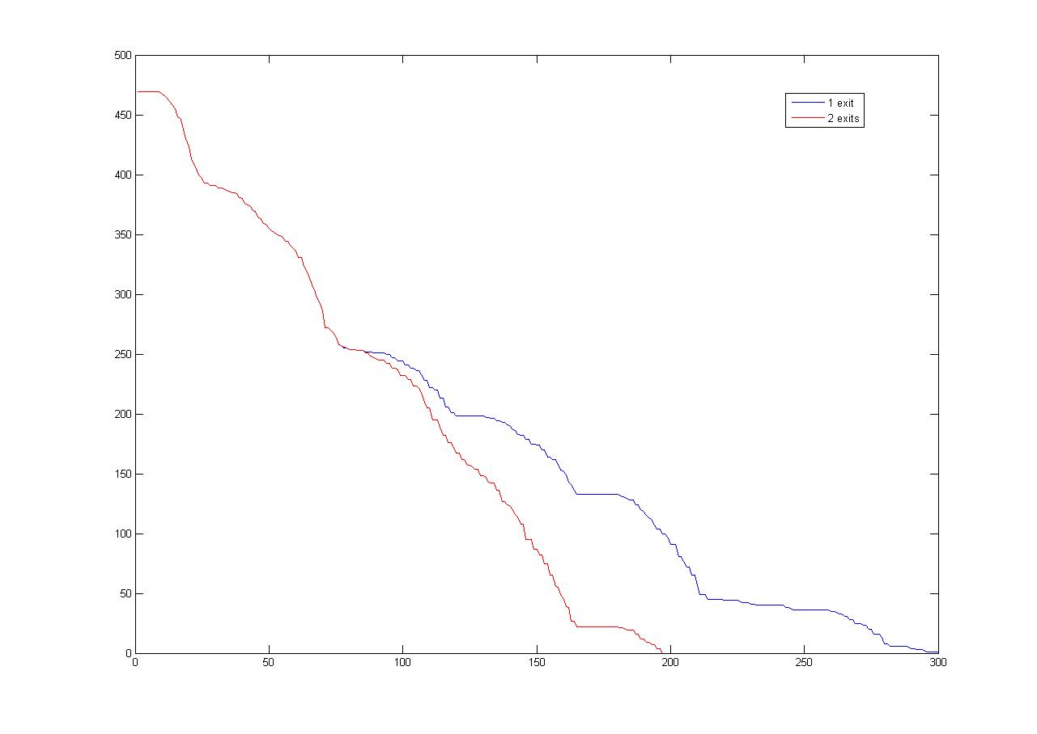

Swiss-Slovak Misunderstanding
One exit vs. two exits

Slide 14
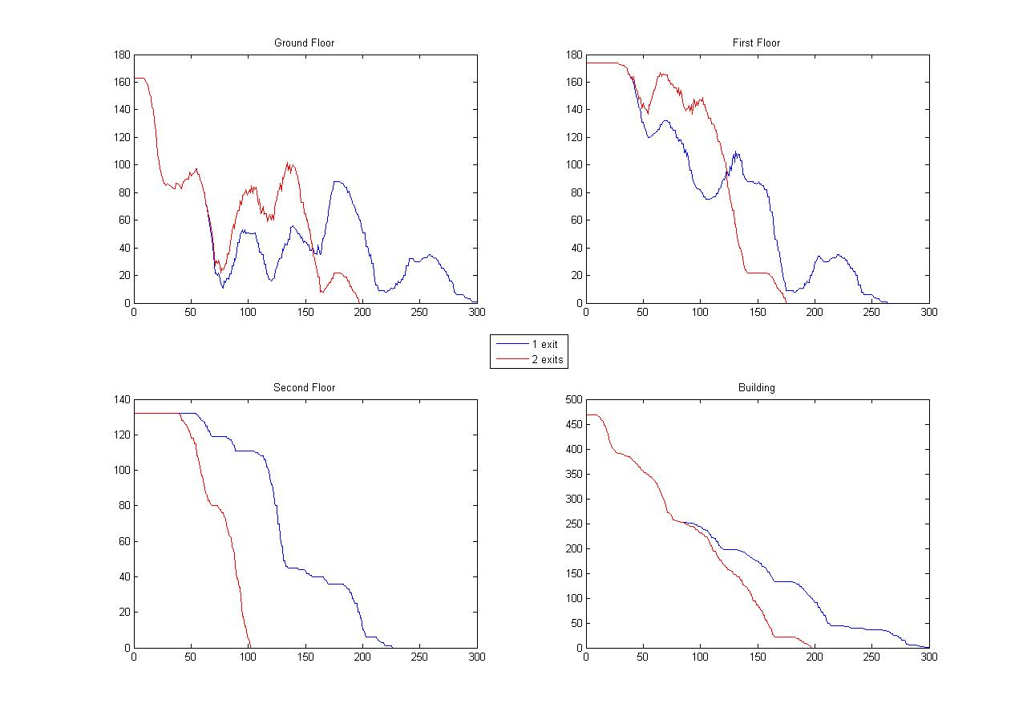
Swiss-Slovak Misunderstanding
Evacuation time

Slide 15
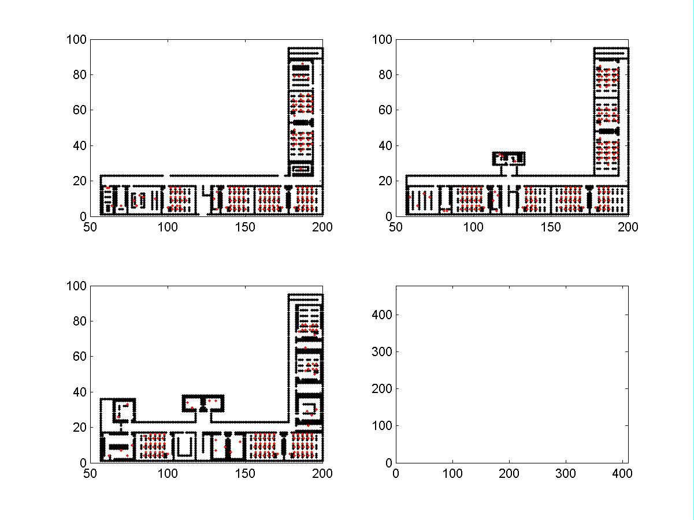

Slide 16
Swiss-Slovak Misunderstanding
Thank you for your Attention
Questions ?
by Alexander Jöhl & Tomáš Nyitray
Swiss-Slovak Misunderstanding

